Slide 1


Computer Forensics: Individual CTF CMIT 424 <2232> Reece Zunino 4/2/2023

Slide 2
Introduction
CTF events take their name from the family game of competing for a real-life flag that has to be “captured” from another team [1].
It’s important that beginners have some challenges to tackle since this is first and foremost a learning event [1].
The top winners in a CTF event get challenge coins. But everyone taking part should walk away feeling like they had a good time and up-leveled their digital forensics skills [1].

Slide 3
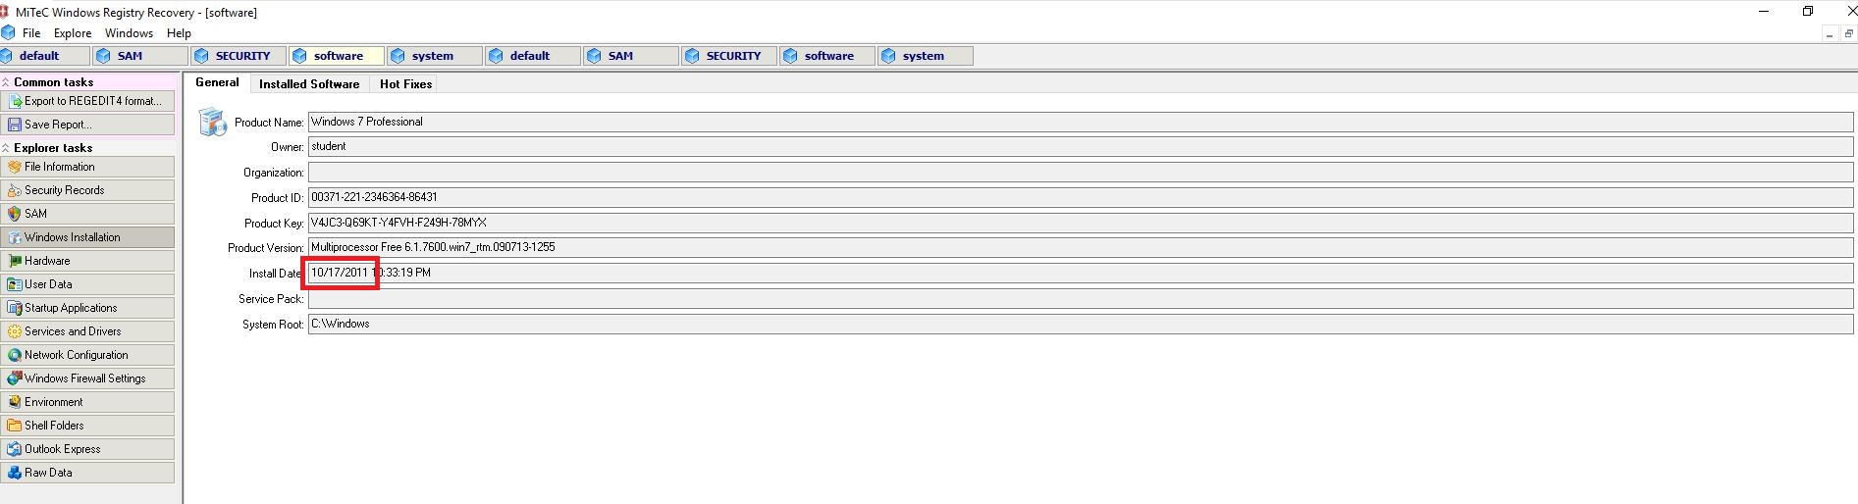
Forensics CTF Problem 1 Attempted
Category: 1
Question#: 1
Question: What is the install date of the Windows client (Format XX/XX/XXXX)?
My Verified Solution: 10/17/2011

Slide 4
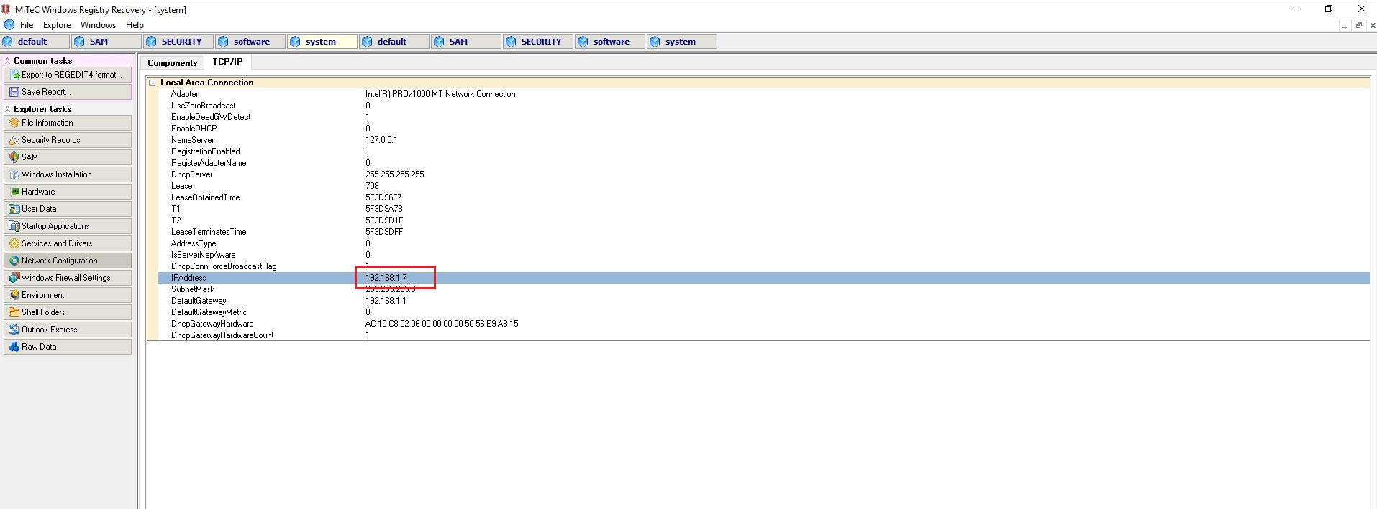
Forensics CTF Problem 2 Attempted
Category: 1
Question#: 2
Question: What is the IP Address of the Windows client?
My Verified Solution: 192.168.1.7

Slide 5
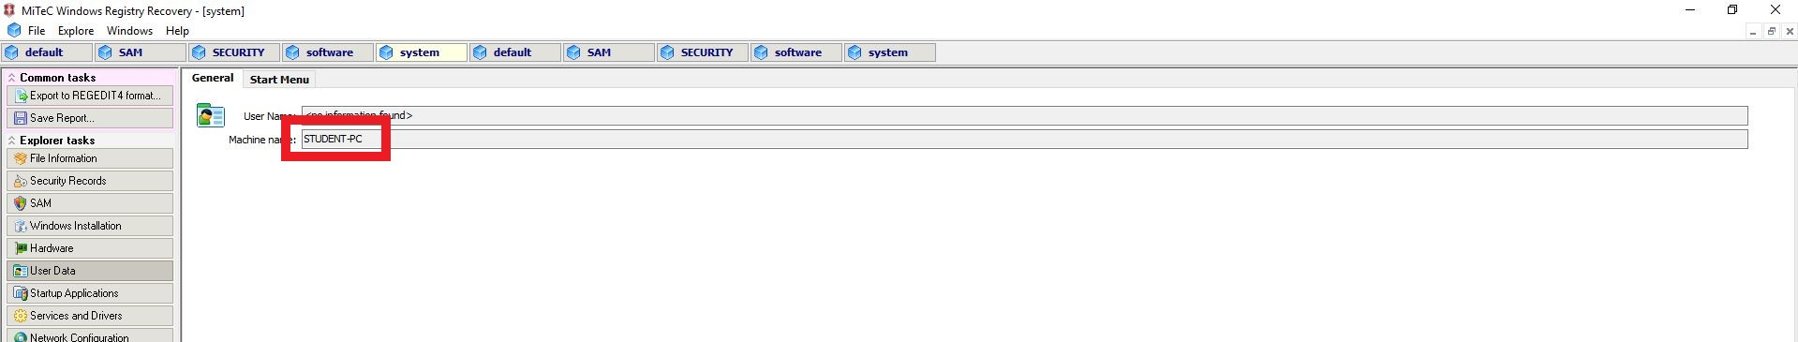
Forensics CTF Problem 3 Attempted
Category: 1
Question#: 3
Question: What is the computer name of the Windows client?
My Verified Solution: STUDENT-PC

Slide 6
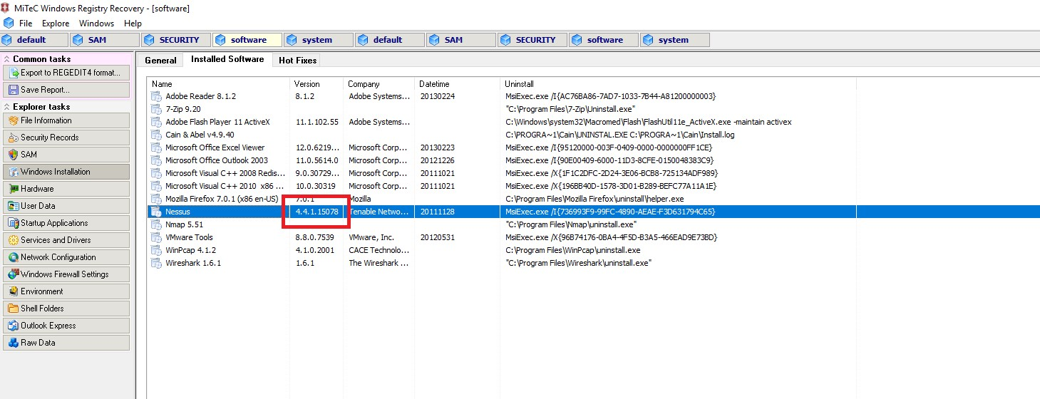
Forensics CTF Problem 3 Attempted
Category: 1
Question#: 5
Question: What is the exact version of Nessus installed on the Windows client?
My Verified Solution: 4.4.1.15078

Slide 7
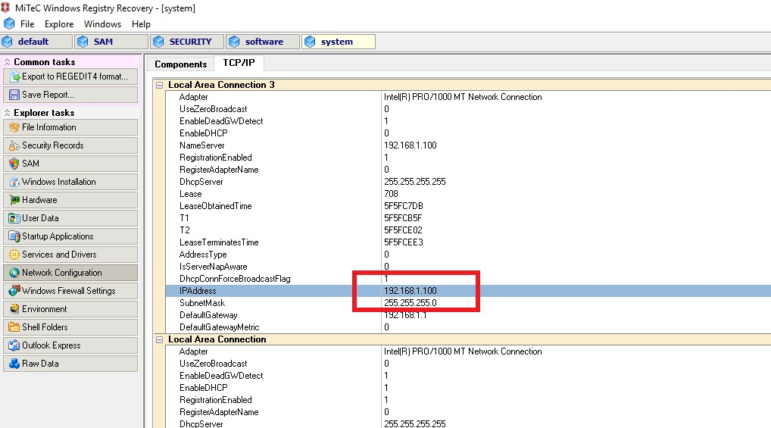
Forensics CTF Problem 4 Attempted
Category: 1
Question#: 6
Question: What is the IP Address of the Windows server?
My Verified Solution: 192.168.1.100

Slide 8
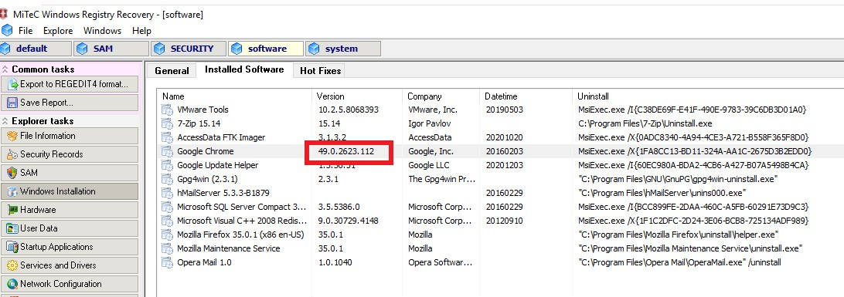
Forensics CTF Problem 5 Attempted
Category: 1
Question#: 8
Question: What is the exact version of Google Chrome installed on the Windows server?
My Verified Solution: 49.0.2623.112

Slide 9
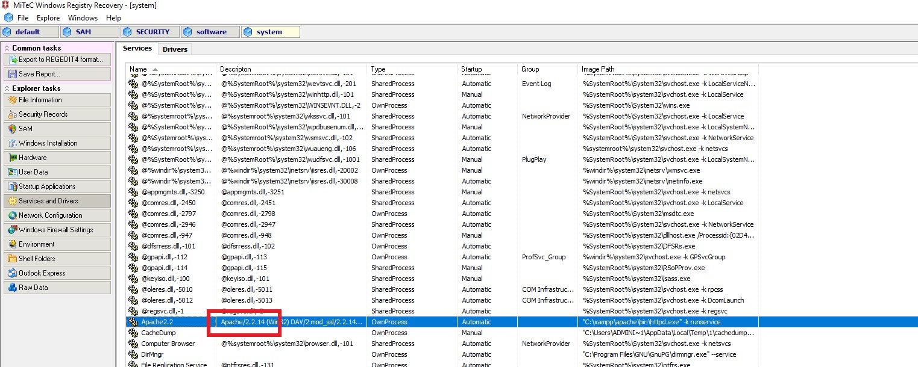
Forensics CTF Problem 6 Attempted
Category: 1
Question#: 10
Question: According to the services in a specific Windows registry key, the Apache service is scheduled to start automatically. What version of Apache is this (Format X.X.XX)?
My Verified Solution: 2.2.14

Slide 10
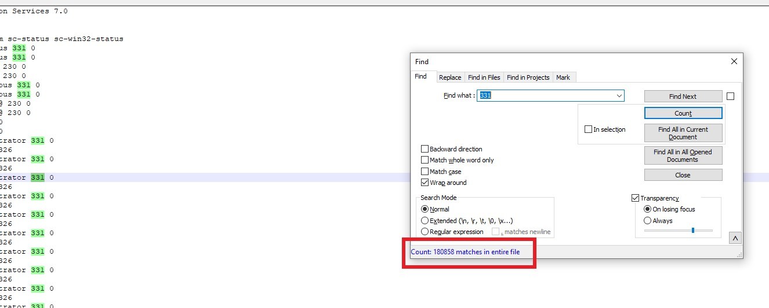
Forensics CTF Problem 7 Attempted
Category: 5
Question#: 4
Question: How many times does the code 331 appear in this file?
My Verified Solution: 180858

Slide 11
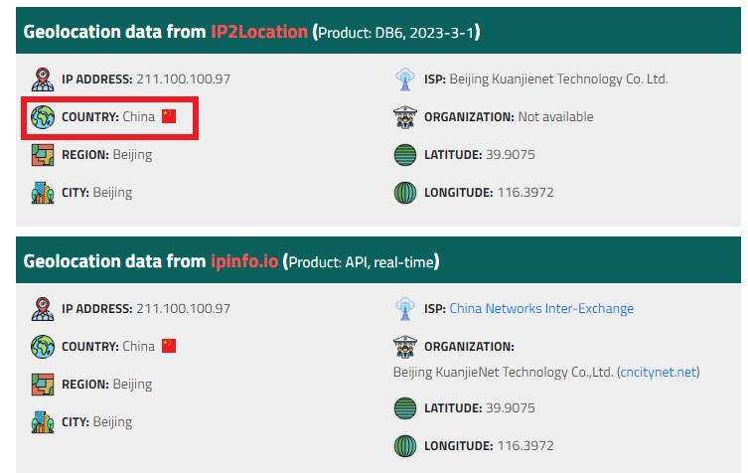
Forensics CTF Problem 8 Attempted
Category: 5
Question#: 5
Question: What country is the attacker from in the question 5 file?
My Verified Solution: CHINA

Slide 12
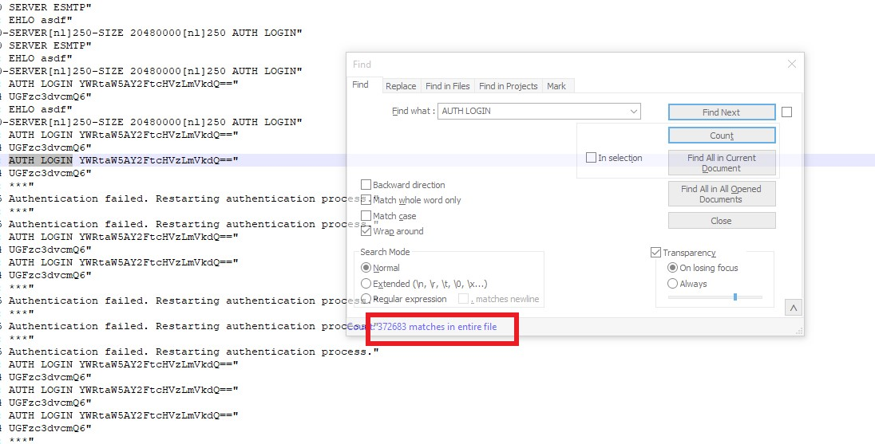
Forensics CTF Problem 9 Attempted
Category: 5
Question#: 7
Question: How many times does the phrase AUTH LOGIN appear in the question 7 file?
My Verified Solution: 372683

Slide 13
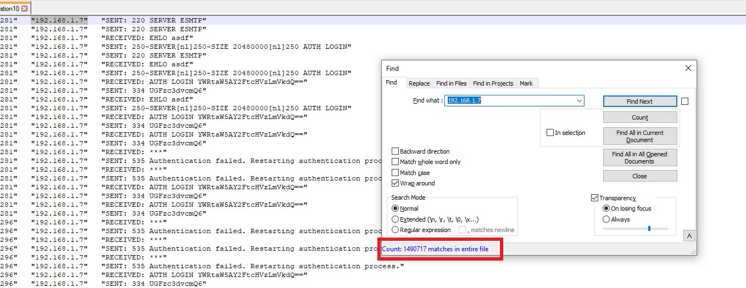
Forensics CTF Problem 10 Attempted
Category: 5
Question#: 10
Question: How many times does the IP Address 192.168.1.7 appear in the question 10 file?
My Verified Solution: 1490717

Slide 14
Summary
CTFs have created a fun way to learn computer forensics for me.
By completing these CTFs, I have enhanced my knowledge of being able to find data where I wouldn’t have looked before
CTFs test my knowledge and understanding of how to find forensic data in different ways using many different tools such as WRR, Notepad, and even a web browser.

Slide 15
References
[1]August 19 and 2022 H. M. S. D. of D. Intelligence, “Digital Forensics 101: The Value of ‘Capture the Flag’ Events,” www.forensicmag.com. https://www.forensicmag.com/3425-Featured-Article-List/589237-Digital-Forensics-101-The-Value-of-Capture-the-Flag-Events/ (accessed Apr. 03, 2023).
[2]V. Li, “Beginner’s Guide to CTFs,” Medium, Aug. 06, 2021. https://infosecwriteups.com/beginners-guide-to-ctfs-c934a0d7f5f9 (accessed Apr. 02, 2023).

